Slide 1
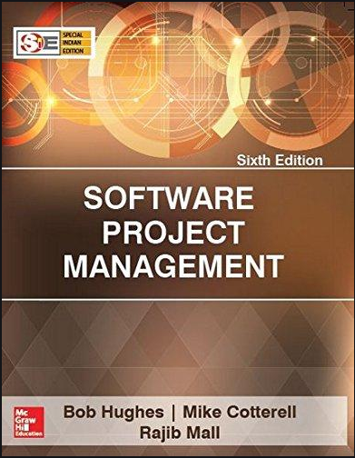
Software Project Management
6th Edition
Chapter 1
An Introduction
Robert Hughes and Mike Cotterell

Slide 2
About the course
3 Credits
Audience:
  Software Engineering
  Computer Science Technology
  Information Management
Previous Courses:
  Software Engineering
  Principle of Management
Text book
  By Bob Hughes and Mike Cotterell
  6th Edition
  PM BoK 5th/6th Edition

Slide 3
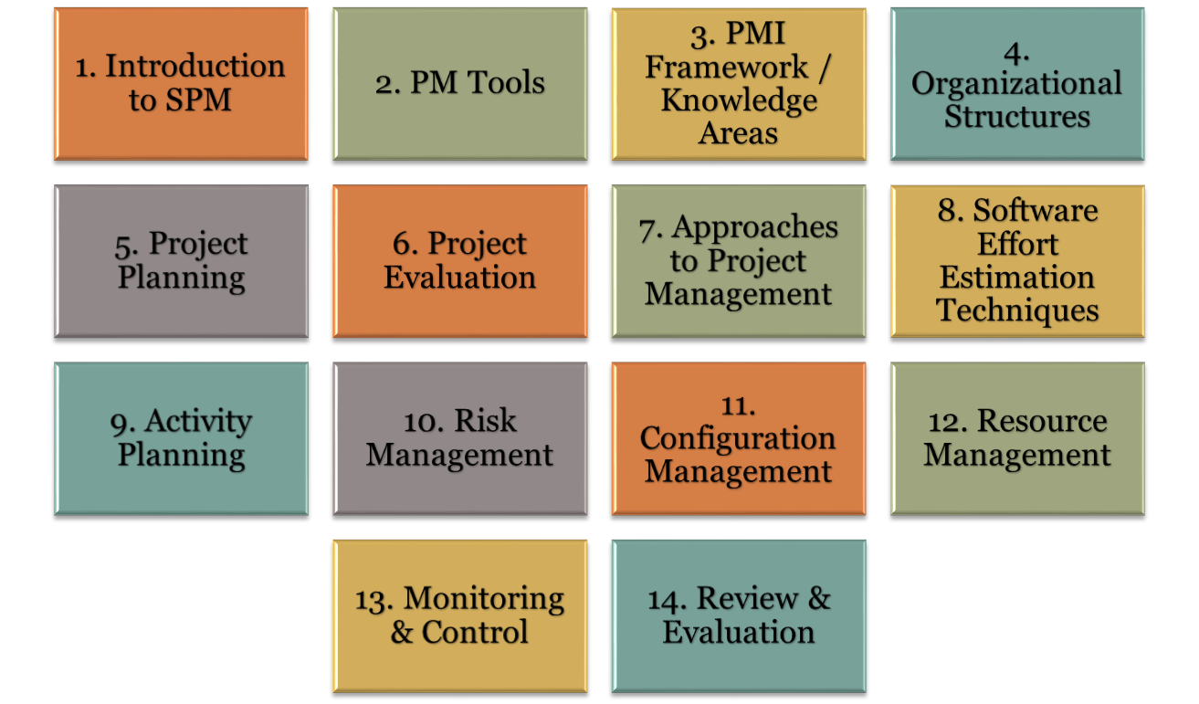
Course Organization

Slide 4
Objectives – Lecture 1
Software Project Versus Other Type of Projects
Dimensions of a Software Project
Activities in SPM
Setting Goals & Objectives
Business Case
Significance of Processes
Project Vs. Program Management
Notes:
The two key questions are:
What exactly is software project management?
This is going to be tackled by looking firstly at what is meant by ‘project’. We are then going to examine whether ‘software project management’ is really different from ‘normal’ project management. Is there anything special about software as opposed to other engineered artefacts?
2. How do we define whether a project is a success or not?
The point about studying project management is to be able to have successful projects. So how do we know if we have been successful?

Slide 5
Why is SPM important?
Unfortunately, projects are not always successful.
  Standish Group in the U.S. analyzed 13,522 projects and concluded that only a third of them were successful; 82 percent were late and 43 percent exceeded their budget.
  The reason for these project shortcomings is often the management of projects.

Slide 6
What is a project?
Some dictionary definitions:
“A specific plan or design”
“A planned undertaking”
“A large undertaking e.g. a public works scheme”
Longmans dictionary
Key points above are planning and size of task
Notes:
Here are some definitions of ‘project’. No doubt there are other ones: for example
‘Unique process, consisting of a set of coordinated and controlled activities with start and finish dates, undertaken to achieve an objective conforming to specific requirements, including constraints of time, cost and resources’
BSO ISO 10006: 1997

Slide 7
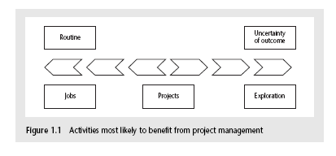
Jobs versus projects
‘Jobs’ – repetition of very well-defined and well understood tasks with very little uncertainty
‘Exploration’ – e.g. finding a cure for cancer: the outcome is very uncertain
‘Projects’ – in the middle!
Notes:
On the one hand there are repetitive jobs a similar task is carried out repeatedly, for example Kwikfit replacing a tyre on a car or a lecturer giving an introductory talk on project management. The task is well-defined and there is very little uncertainty. In some organizations, software development might tend to be like this – in these environments software process management might be more important than software project management
On the other hand some exploratory activities are very uncertain. Some research projects can be like this – we may not be sure what the outcome will be, but we hope that we will learn some things of importance. It may be very difficult to come up with precise plans, although we would probably have some idea of a general approach.
Projects seem to come somewhere between these two extremes. There are usually well-defined hoped-for outcomes but there are risks and uncertainties about achieving those outcomes.

Slide 8
Characteristics of projects
A task is more ‘project-like’ if it is:
Non-routine
Planned
Aiming at a specific target
Work carried out for a customer
Involving several specialisms
Made up of several different phases
Constrained by time and resources
Large and/or complex

Slide 9
Definition of a Project
A project is a temporary endeavor undertaken to create a unique product, service, or result.(PMBoK)
A project is defined as “a temporary organization that is created for the purpose of delivering one or more business products according to an agreed Business Case.” (PRINCE 2)

Slide 10
Are software projects really different from other projects?
Not really! …but…
Invisibility: With software, progress is not immediately visible
Complexity: Per dollar, software products contain more complexity than other engineered artefacts
Conformity: Software developers have to conform to the requirements of human clients
Flexibility: Software systems are particularly subject to change
Notes:
This is based on Fred Brooks’ paper No Silver Bullet: Essence and Accidents of Software Engineering which appeared in IEEE Computer 20(4) pp10-19 April 1987

Slide 11
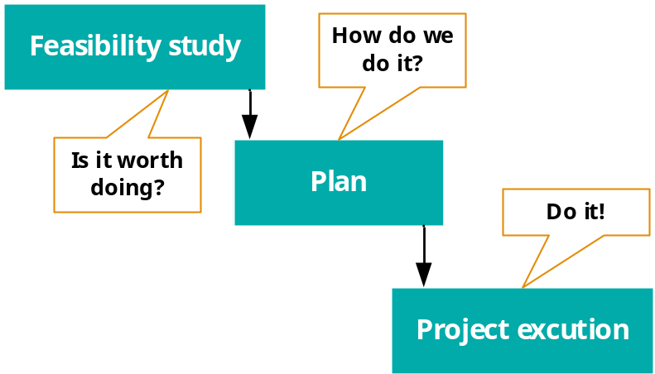
Activities covered by project management
A software project is not only concerned with the actual writing of software. In fact, where a software application is bought in “of the shelf”, there may be no software writing as such, but this is still fundamentally a software project because so many of the other activities associated with software will still be present.
Three successive processes
Notes:
There are two key points here.
Often you see something like ‘feasibility study’ being put as the first stage of development life cycle, and indeed it might be. However, the outcome of the feasibility study might be not to carry out the proposed project. Planning of the project should therefore take place after the feasibility study (or as a part of the feasibility study perhaps). Clearly the feasibility study itself might need a plan.
All plans are to some extent provisional and subject to change. The key point is that the evolving plan allows us to control the project.

Slide 12
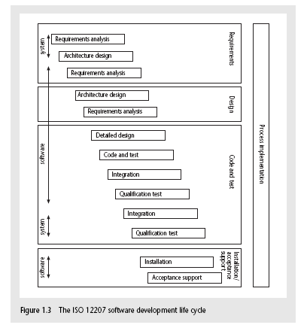
The software development life-cycle (ISO 12207)
Notes:
This section of the lecture discusses the software development life cycle. Note that this is a technical model. It identifies the technical constraints on the order activities are done. This does NOT imply that a ‘waterfall’ approach is the only way to organize projects. The technical model could be implemented as increments or in an evolutionary manner.

Slide 13
ISO 12207 life-cycle
Requirements analysis
  Requirements elicitation: what does the client need?
  Analysis: converting ‘customer-facing’ requirements into equivalents that developers can understand
  Requirements will cover
    Functions
    Quality
    Resource constraints i.e. costs
Notes:
The key point here is that requirement analysis has to face in (at least) two different directions. It needs to communicate and elicit the requirements of the users, speaking in their language. It needs to organize and translate those requirements into a form that developers can understand and relate to.

Slide 14
ISO 12207 life-cycle
Architecture design
  Based on system requirements
  Defines components of system: hardware, software, organizational
  Software requirements will come out of this
Code and test
  Of individual components
Integration
  Putting the components together
Notes:
The software project will almost certainly be part of a larger project which has non-software elements. In a software engineering environment it could be the software will be embedded in hardware product of some kind. Thus there are system requirements for the product as a whole and software requirements for the software element.
In a business information systems environment, the software development could be a relatively minor part of a much larger organizational change project.

Slide 15
ISO12207 continued
Qualification testing
  Testing the system (not just the software)
Installation
  The process of making the system operational
  Includes setting up standing data, setting system parameters, installing on operational hardware platforms, user training etc
Acceptance support
  Including maintenance and enhancement
Notes:
The confusion about what ‘implementation’ really means could be mentioned. Does it mean implementing the design (that is, coding) or implementing the complete system in its user environment? It is best to use ‘installation’ to describe the latter in order to avoid confusion.

Slide 16
Some ways of categorizing projects
Compulsory vs. voluntary users
  Supermarket transaction system vs. computer game
Information systems vs. embedded systems
  Office system vs. machine control system
Objectives vs. products
  to meet certain objectives vs. to produce a product.
Notes:
With objective-based projects, a general objective or problem is defined, and there are several different ways in which that objective could be reached. The project team have freedom to select what appears to be the most appropriate approach.
With product-based projects, the product is already very strictly defined and the development team’s job is to implement the specification with which they have been presented.
Arguably, information systems projects are more likely to be objective-based than is the case with software engineering.
In many cases, an objective-based project could consider a problem and recommend a solution that is then implemented by a product-based project.
Exercise 1.5 in the text is relevant here.

Slide 17
Setting objectives
Answering the question ‘What do we have to do to have a success?’
Need for a project authority
  Sets the project scope
  Allocates/approves costs
Could be one person - or a group
  Project Board
  Project Management Board
  Steering committee
Notes:
Different people who are involved in a project (Stakeholders) will have different interests in the project and are likely to see different outcomes as being important.
For example, end-users would want a system that is ‘user-friendly’, that is, easy to learn and to use, and a system that helps rather than hinders them from doing their jobs. Their managers may be more interested in whether the new system would allow them to reduce staffing levels.
It is important therefore that a set of clearly defined objectives are identified and published for the project. Some individual or group needs to be pinpointed who acts as the main client for the project.
See Exercise 1.7 in the text.

Slide 18
Objectives
Informally, the objective of a project can be defined by completing the statement:
The project will be regarded as a success if………………………………..
Rather like post-conditions for the project
Focus on what will be put in place, rather than how activities will be carried out
Notes:
The focus here needs to be on what the situation will be when the project is completed. In what ways will the world be different? The objectives should avoid describing activities:
e.g. ‘a new payroll application will be operational by 4th April’ not ‘design and code a new payroll application’

Slide 19
Objectives should be SMART
S – specific, that is, concrete and well-defined
M – measurable, that is, satisfaction of the objective can be objectively judged
A – achievable, that is, it is within the power of the individual or group concerned to meet the target
R – relevant, the objective must relevant to the true purpose of the project
T – time constrained: there is defined point in time by which the objective should be achieved
Notes:
I have seen some places where the R is said to stand for ‘resource-constrained’, that is that there is a target cost associated with the achievement of the objective.

Slide 20
Goals/sub-objectives
These are steps along the way to achieving the objective. Informally, these can be defined by completing the sentence…
Objective X will be achieved
IF the following goals are all achieved
A……………
B……………
C…………… etc
Notes:
Scoring a goal in football is a ‘goal’ or sub-objective on the way to achieving the overall objective of winning the match. Sub-objectives and objectives can be nested in a hierarchy, so that the objective of winning the match could itself be a goal or sub-objective on the way to winning the league etc.

Slide 21
Goals/sub-objectives continued
Often a goal can be allocated to an individual.
Individual may have the capability of achieving goal, but not the objective on their own e.g.
Objective – user satisfaction with software product
Analyst goal – accurate requirements
Developer goal – software that is reliable
Notes:
Goals can be formulated in such a way that they represent what an individual or group need to do to contribute to the success of the project’s objectives.
In the example above, the analyst or developer, by themselves, cannot guarantee user satisfaction. However, the analyst can contribute to the achievement of the objective by making sure the users’ requirements are accurately recorded and the developer by making sure that the software is reliable.
See Exercise 1.7 in the text.

Slide 22
Measures of effectiveness
How do we know that the goal or objective has been achieved?
By a practical test, that can be objectively assessed.
e.g. for user satisfaction with software product:
Repeat business – they buy further products from us
Number of complaints – if low etc etc
Notes:
See Exercise 1.8 in the text.

Slide 23
Stakeholders
These are people who have a stake or interest in the project
In general, they could be users/clients or developers/implementers
They could be:
Within the project team
Outside the project team, but within the same organization
Outside both the project team and the organization
Notes:
Each stakeholder will have their own goals and concerns in relation to the project which may be different from those of the project as a whole. For example, a software developer might work to make a living, pay the mortgage, learn new things, solve interesting problems. The main stakeholders need, however, to understand and accept the overall project objectives.

Slide 24
The business case
Benefits of delivered project must outweigh costs
Costs include:
  Development
  Operation
Benefits
  - Quantifiable
  - Non-quantifiable
Benefits
£
Costs
£
Notes:
It is not always possible to put a precise financial on the benefits of a project. The client’s willingness to pay up to a certain price to get a project implemented implies that they have informally identified a value to them of getting that project implemented.

Slide 25
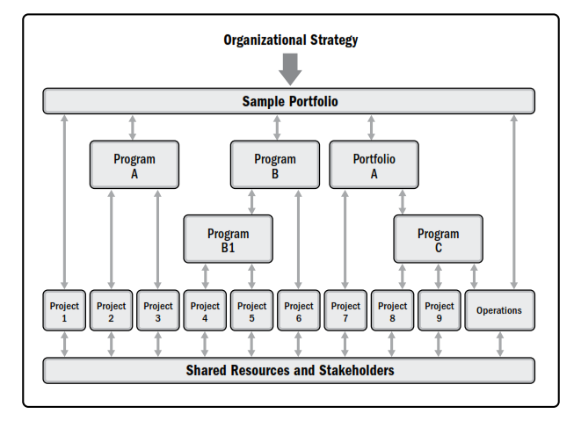
Project VS Program Management
Notes:
A program is a group of related projects, subsidiary programs, and program activities that are managed in a coordinated manner to obtain benefits not available from managing them individually.

Slide 26
Key points in lecture
Projects are non-routine - thus uncertain
The particular problems of projects e.g. lack of visibility
Clear objectives are essential which can be objectively assessed
Stuff happens. Not usually possible to keep precisely plan – need for control
Communicate, communicate, communicate!

